Slide 1
Stack frames and Tail Call Recursion
Varun Dey

Slide 2
Speaker Bio
SRM Alumni - class of 2017
Associate Software Engineer - Symantec Corp
Helps making Norton extensions better - IDSafe and Safe Web
Vanilla and React JS + Python
Full stack web developer
Still trying to get head around this
Open source is ❤
https://varundey.me
Notes:
JS this

Slide 3
Overview
Recursion
Stack and stack frames
Fibonacci sequence
Find the n^{th} fibonacci number
PyCharm benchmarking tool
2.5 GHz Intel Core i7 Macbook Pro
16 GB 1600 MHz DDR3
Python (duh!)

Slide 4
Fibonacci - Naive way
(read boring way)

Slide 5
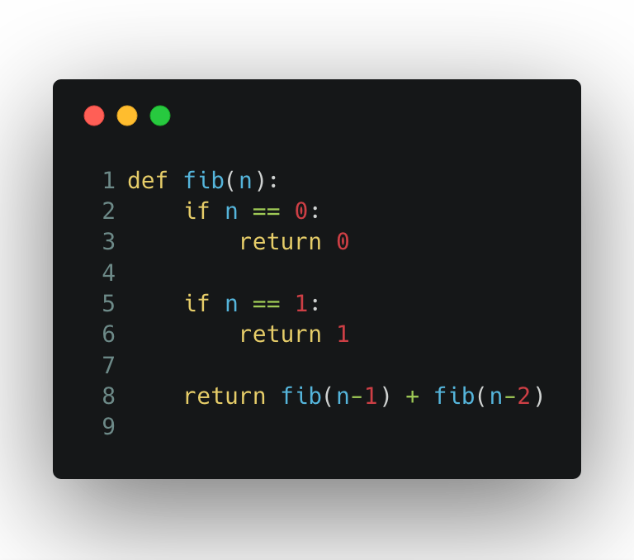
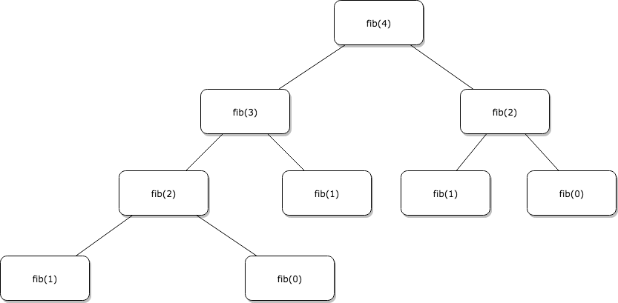

Slide 6
But if it works, it works right?
What if we have a stack of size [10]

Slide 7
stack [10]
fib(4)
fib(3)
fib(2)
fib(1)
Stack frame
fib(0)
fib(1)
fib(2)
fib(1)
fib(0)

Slide 8
But if it works, it works right?
Takes exponential time O(2^{n})
Allocates separate stack frame for each recursive call
Will easily hit stack overflow
What if we have a stack of size [10]
💣

Slide 9
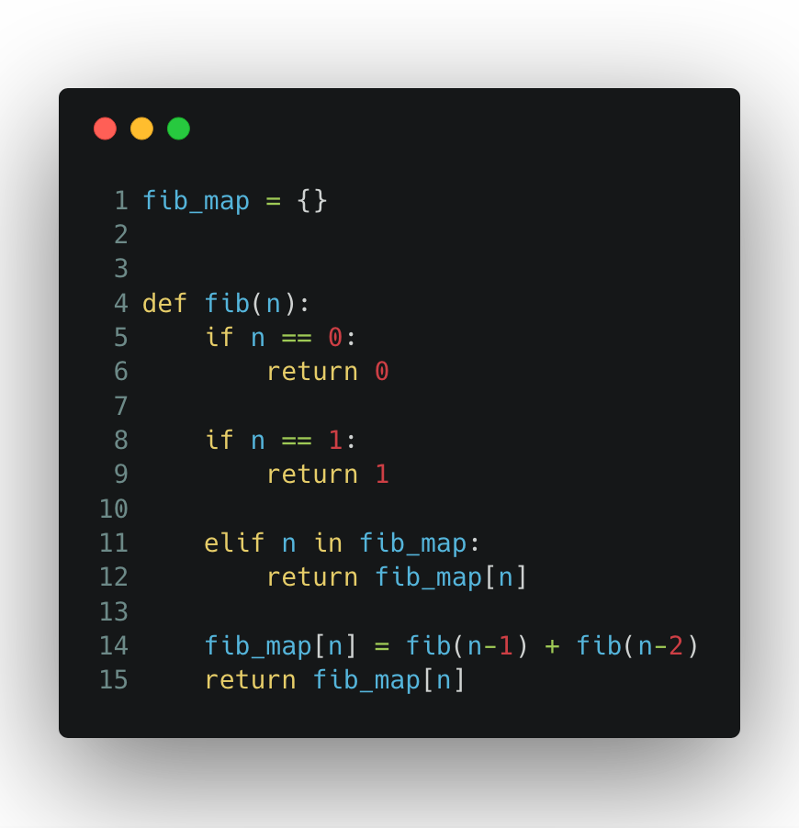
✋
Memoization?

Slide 10
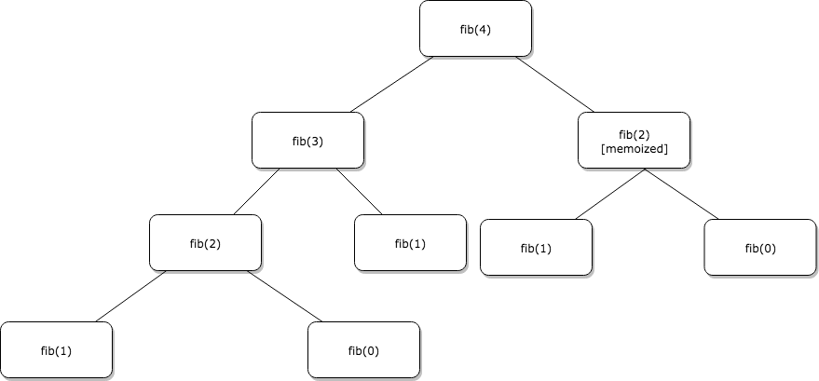
Top - down recursive approach
Cache as you calculate
Time Complexity - O(n)

Slide 11
Let’s benchmark Naive vs Memoization
n | Time(ms) |  | Call count
 | Naive | Memoization | Naive | Memoization
10 | 0 | 0 | 177 | 19
20 | 8 | 0 | 21891 | 39
30 | 724 | 0 | 2692537 | 59
150 | Too long | 0 | Too long | 299
500 | Too long | 1 | Too long | 999
1000 | Maximum recursion depth exceeded

Slide 12
Stack overflow for n = 1000???
Introducing Tail Call Optimisation

Slide 13
Tail call optimisation
A tail call is a subroutine call performed as the final action of a procedure. (Thanks Wikipedia!)
.translateTo(‘English’)
Tail call optimisation occurs when the last thing to evaluate before a function return is a function invocation
Interpreter can reuse current stack frame for the function call instead of creating new one.
Tail call optimisation is about structuring your code - there’s no syntax for it. Especially no JS library. :(

Slide 14
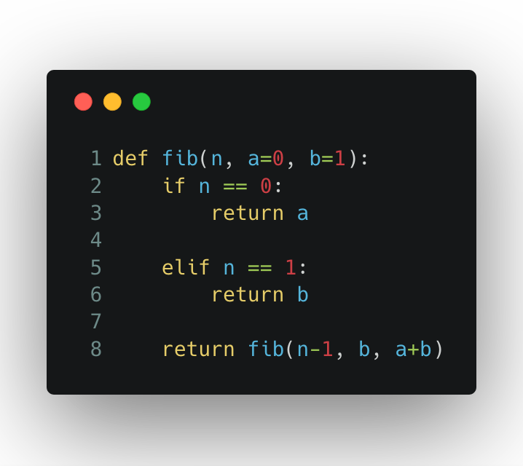
Tail call optimisation - an example
Time complexity - O(n)
Space complexity O(1)
Uses same stack frames

Slide 15
Benchmarking Memoization vs Tail Call Recursion
n | Time (ms) |  | Call count
 | Memoization | Tail Call Recursion | Memoization | Tail Call Recursion
150 | 0 | 0 | 299 | 150
300 | 0 | 0 | 599 | 300
500 | 1 | 1 | 999 | 500
950 | 2 | 2 | 1899 | 950
1000 | Maximum recursion depth exceeded

Slide 16
Stack overflow again??!?
Python does not optimise Tail call Recursions
Because Guido van Rossum prefers to be able to have proper tracebacks
https://neopythonic.blogspot.com/2009/04/final-words-on-tail-calls.html
What treachery!!

Slide 17
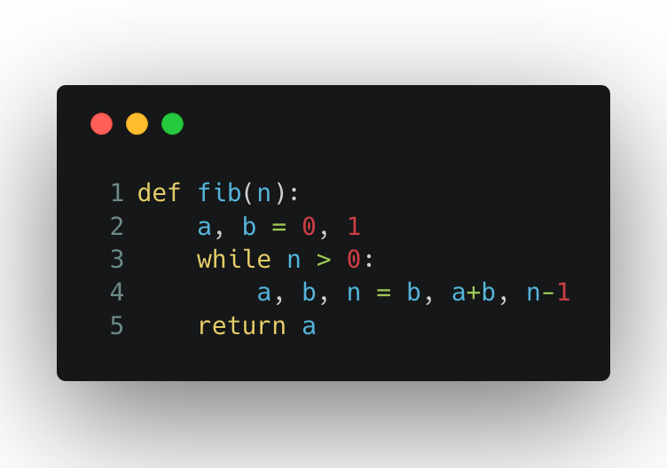
Iterative Tail call optimisation
Notes:
Very famous interview question - to solve recursion in O(n) time complexity

Slide 18
Benchmarking TCO vs Iterative TCO
n | Time (ms) |  | Call count
 | TCO | Iterative TCO | TCO | Iterative TCO
500 | 1 | 0 | 500 | 1
750 | 1 | 0 | 750 | 1
995 | 1 | 0 | 995 | 1
1200 | Maximum Recursion Depth Reached | 0 | Maximum Recursion Depth Reached | 1
7000 |  | 2 |  | 1
100000 |  | 124 |  | 1

Slide 19
Revisiting
Tail call optimisations are taken care by interpreter
The last thing that needs to be evaluated before function return statement should be a function call
Should be no functional computation happening. Eg - fib(n-2) + fib(n-1)
Notes:
Circumstances when current stack frame is reused

Slide 20
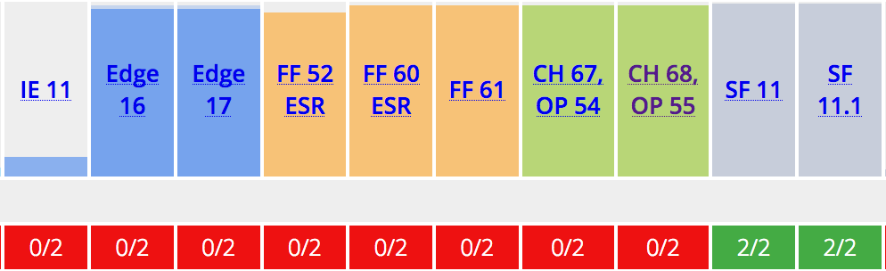
JS takeaways
Recursive call should not need access to any variable in current stack frame
ES5 does not support tail call optimisations
For ES6 and above, tail call is only supported in Safari
“Even though tail call optimization is part of the language specification, it isn’t supported by many engines and that may never change.” - Dr. Axel Rauschmayer (http://2ality.com/2015/06/tail-call-optimization.html)
https://kangax.github.io/compat-table/es6/#test-proper_tail_calls_(tail_call_optimisation)

Slide 21
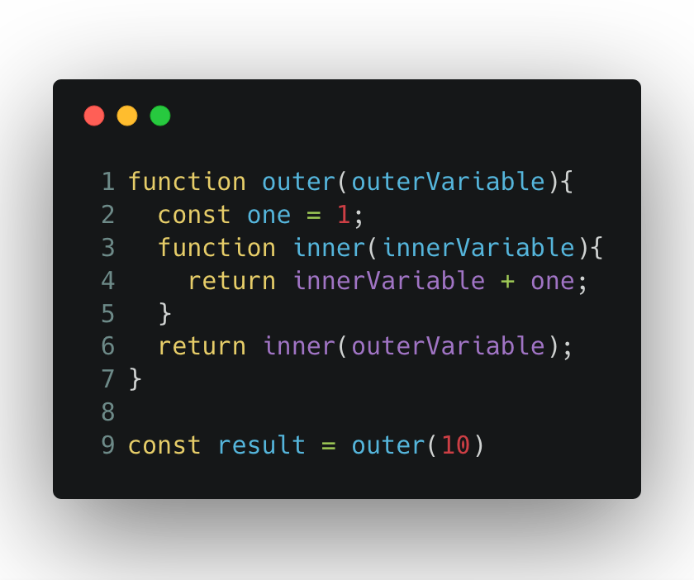
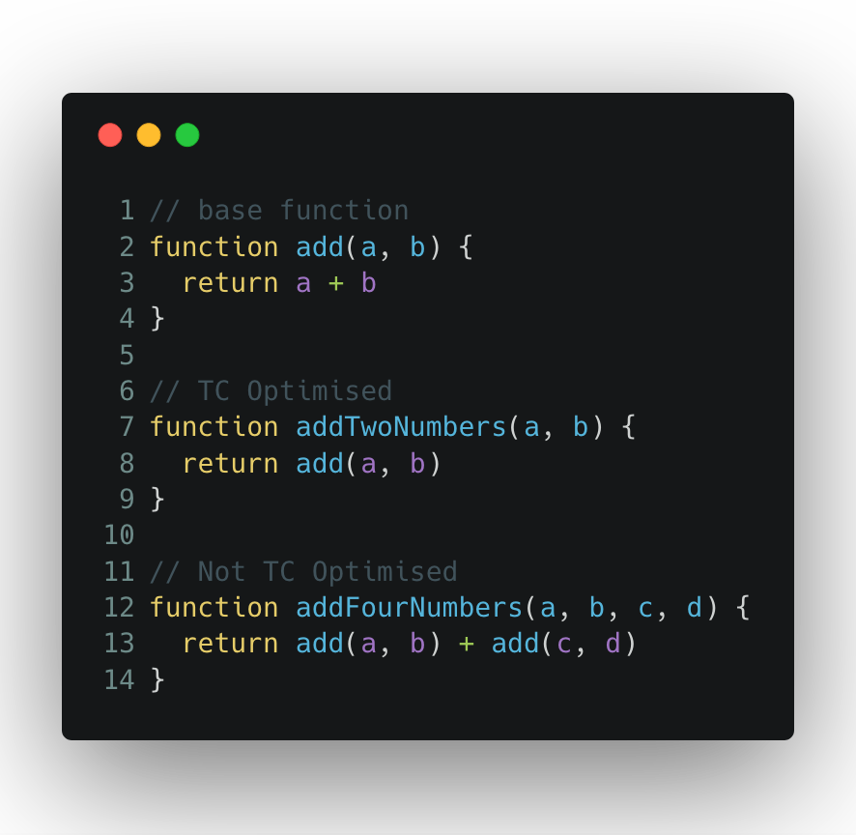

Slide 22
Thanks for listening.
Questions?
https://varundey.me

